Slide 1
Learning State Machines
Learning in the limit, Myhill-Nerode, the Hankel matrix, Active and Passive learning
Sicco Verwer
http://cybersecurity.tudelft.nl/users/sicco-verwer

Slide 2
Learning (reverse-engineering)
Execution logs form a big data set from which can be used to gain information about a system or protocol
This can help to
analyze your own code and hunt for bugs, or
reverse-engineer someone else’s unknown protocol, eg. a botnet, to fingerprint or to analyze (and attack)

Slide 3
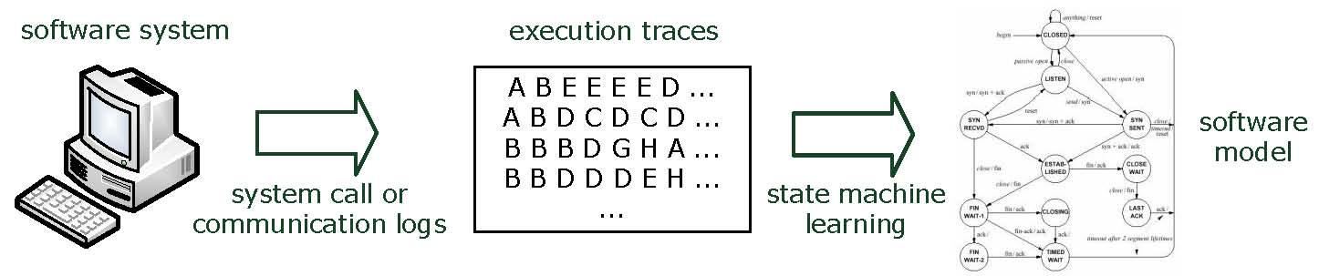
State machine learning
Software leaves traces
A state machine is a logical model describing these traces
Classification – is a new trace generated by the same software?
Prediction – what trace is most likely to occur next?
Analysis – is the software deadlock-free, secure, malicious?
Sicco Verwer

Slide 4
Learning DFAs from labeled data
Input:
Labeled data, positive and negative traces
Goal:
Find the smallest DFA that is consistent with the data

Slide 5
Learning DFAs from labeled data
Input:
Labeled data, positive and negative traces
Goal:
Find the smallest DFA that is consistent with the data
Occam’s razor
Among competing hypotheses, the one with the fewest assumptions should be selected.

Slide 6
Example
1 9 1 0 0 0 0 0 0 0 0
1 15 0 1 1 0 0 0 1 0 1 0 1 0 1 0 0
0 5 0 1 0 0 0
1 2 0 0
0 12 1 1 0 0 0 0 0 0 0 1 0 0
1 5 1 0 1 0 0
1 3 1 0 0
0 6 0 0 0 0 0 1
1 3 1 0 1
0 20 1 0 0 0 0 0 1 0 1 0 0 0 0 0 1 1 1 0 0 0
0 13 0 1 1 1 0 1 0 0 0 0 0 0 0
1 3 1 0 1
1 7 1 0 0 0 0 0 0

Slide 7
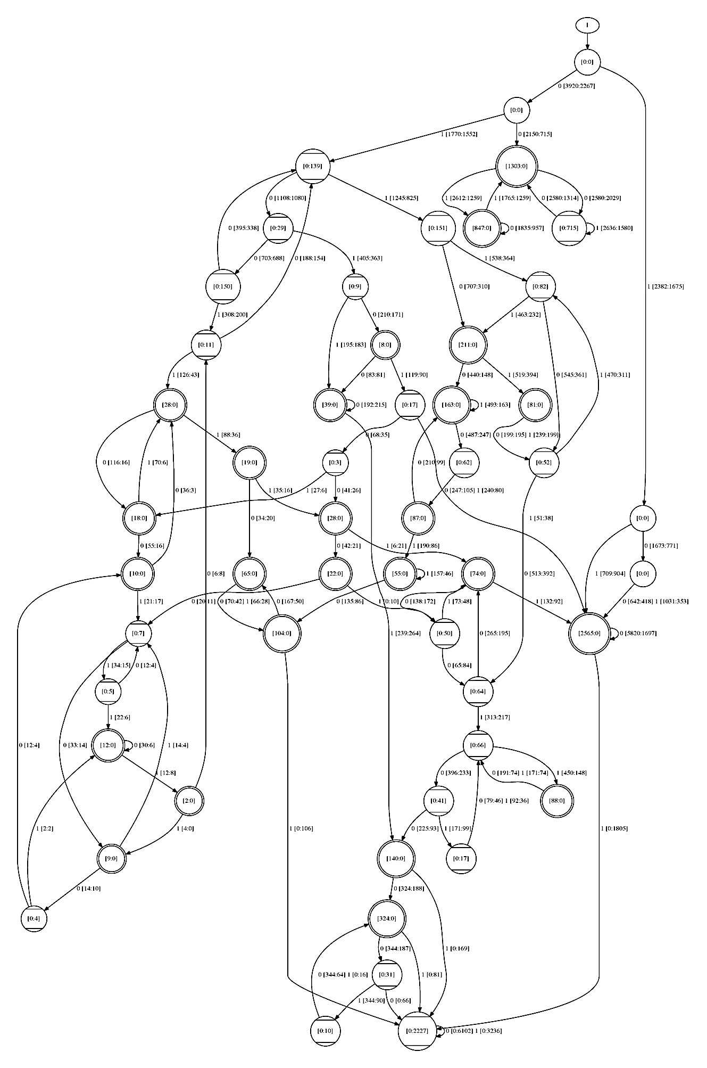
Example
1 9 1 0 0 0 0 0 0 0 0
1 15 0 1 1 0 0 0 1 0 1 0 1 0 1 0 0
0 5 0 1 0 0 0
1 2 0 0
0 12 1 1 0 0 0 0 0 0 0 1 0 0
1 5 1 0 1 0 0
1 3 1 0 0
0 6 0 0 0 0 0 1
1 3 1 0 1
0 20 1 0 0 0 0 0 1 0 1 0 0 0 0 0 1 1 1 0 0 0
0 13 0 1 1 1 0 1 0 0 0 0 0 0 0
1 3 1 0 1
1 7 1 0 0 0 0 0 0
….
10244 strings in total

Slide 8
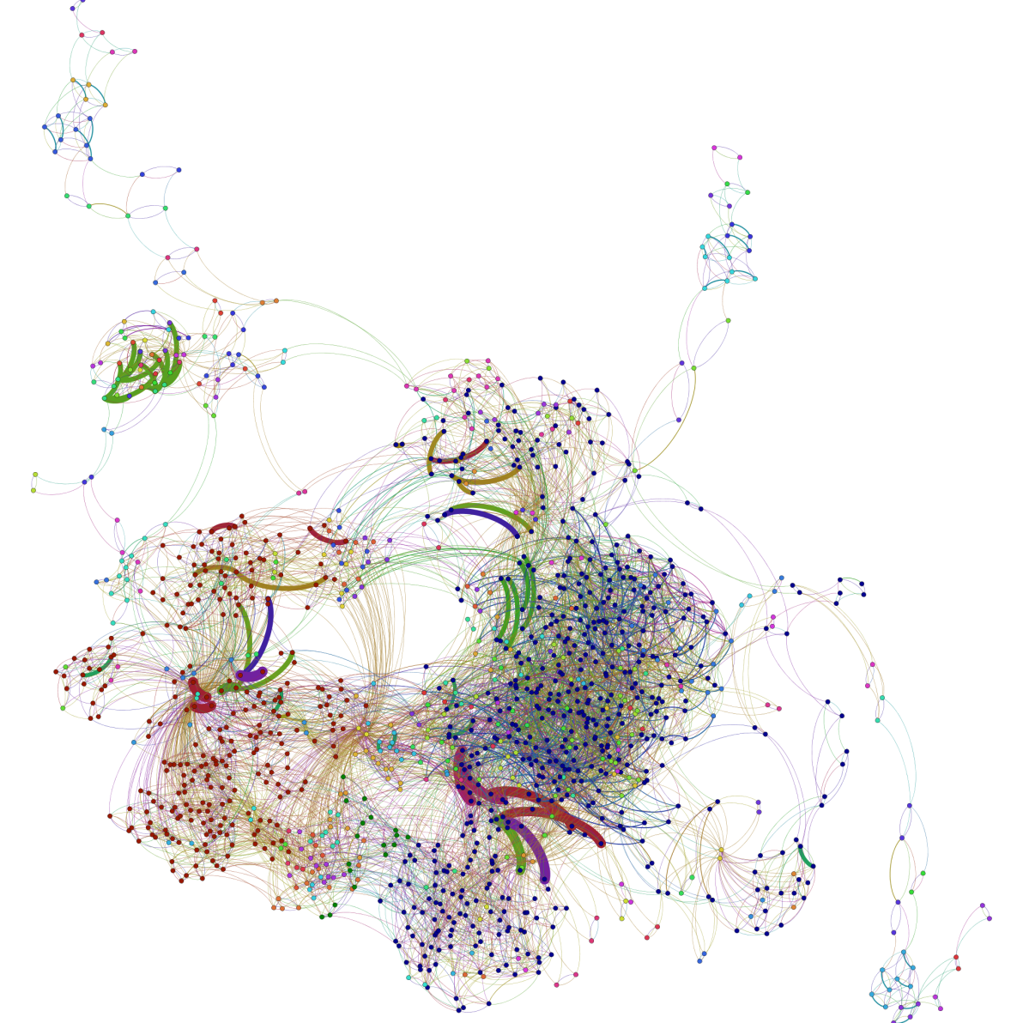
Printer controller, Smeenk et al. 2013
Notes:
Generated using Gephi tool

Slide 9
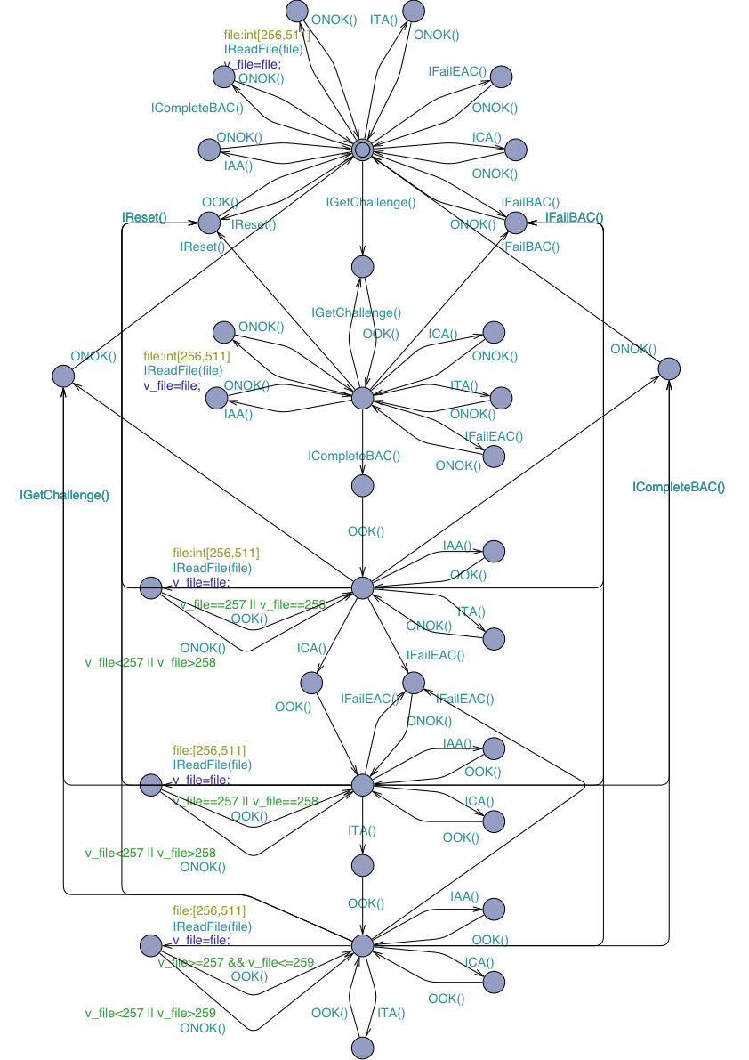
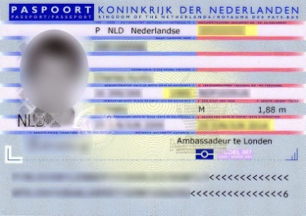

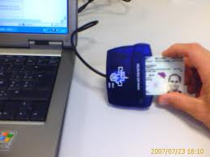

Biometric Passport, Aarts et al. 2010

Slide 10
Using state machines
Analyzing the models by hand, or with model checker, for flaws
to see if all paths are correct & secure
Fuzzing or model-based testing
using the diagram as basis for “deeper” fuzz testing
Program verification
proving that there is no functionality beyond that in the diagram, which using testing you can never establish
Using it when doing a manual code review

Slide 11
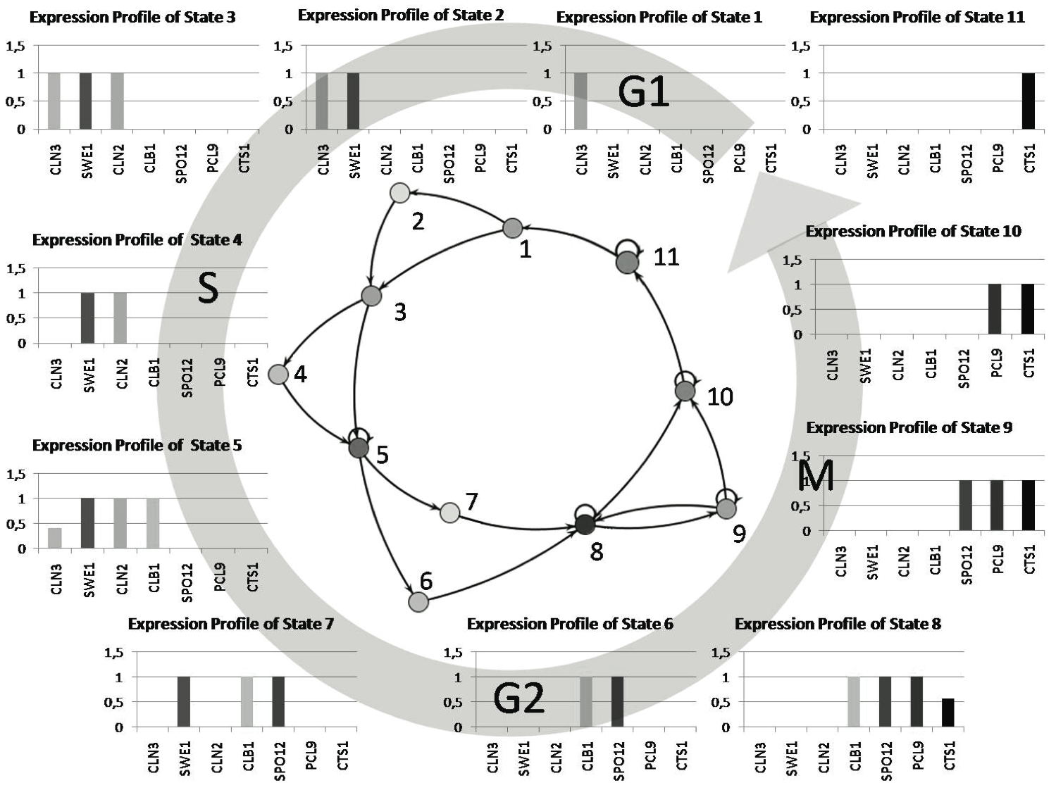
Yeast cycle, Schmidt et al. 2013

Slide 12


Preventing botnets
Traditional
code analysis and finding malware fingerprints
Code/binary analysis is mostly manual and increasingly harder
Code obfuscation
Encryption
Self-modifying
Behavior-based analysis is much harder to thwart
Bots need to communicate!
Sicco Verwer

Slide 13






Botnet
Client
Cyber
Criminal
Bank Server
Bot
Bot
Client

Slide 14
We observe internet traffic
SYN, SYN-ACK, ACK, SEQ, ACK, SEQ, ACK, SEQ, ACK, FIN-ACK, ACK, FIN-ACK
SYN, SYN-ACK, ACK, FIN-ACK, ACK, FIN-ACK
SYN, SYN-ACK, ACK, SEQ, ACK, FIN-ACK, ACK, FIN-ACK
…..

Slide 15


SEQ
FIN
ACK
SEQ
ACK
ACK
SYN
DATA
SYN,ACK
FIN
ACK
ACK
SEQ
ACK
SEQ
ACK

Slide 16
Learning (reverse-engineering)
Execution logs form a big data set from which can be used to gain information about a system or protocol
This can help to
analyze your own code and hunt for bugs, or
reverse-engineer someone else’s unknown protocol, eg. a botnet, to fingerprint or to analyze (and attack)

Slide 17
We observe internet traffic
SYN, SYN-ACK, ACK, SEQ, ACK, SEQ, ACK, SEQ, ACK, FIN-ACK, ACK, FIN-ACK
SYN, SYN-ACK, ACK, FIN-ACK, ACK, FIN-ACK
SYN, SYN-ACK, ACK, SEQ, ACK, FIN-ACK, ACK, FIN-ACK
…..

Slide 18
First: make abstract
A, B, C, D, C, D, C, D, C, E, C, E
A, B, C, E, C, E
A, B, C, D, C, E, C, E
…..

Slide 19
Then: look for patterns!
A, B, C, D, C, D, C, D, C, E, C, E
A, B, C, E, C, E
A, B, C, D, C, E, C, E
…..

Slide 20
Then: look for patterns!
A, B, C, D, C, D, C, D, C, E, C, E
A, B, C, E, C, E
A, B, C, D, C, E, C, E
…..

Slide 21
Then: look for patterns!
A, B, C, D, C, D, C, D, C, E, C, E
A, B, C, E, C, E
A, B, C, D, C, E, C, E
…..

Slide 22
Then: look for patterns!
A, B, C, D, C, D, C, D, C, E, C, E
A, B, C, E, C, E
A, B, C, D, C, E, C, E
…..

Slide 23
Then: look for patterns!
A, B, C, D, C, D, C, D, C, E, C, E
A, B, C, E, C, E
A, B, C, D, C, E, C, E
…..

Slide 24
Examples – botnet traffic
Sicco Verwer

Slide 25
Botnet traffic NetFlow data
Sicco Verwer

Slide 26
NetFlow data --- fingerprinting
4 scenarios: click-fraud, spamming, DDoS, …
For each scenario:
Learn state machine model from 1 malicious host
Behavioral difference is small → malicious
TP | TN | FP | FN
9 | 377 | 0 | 0
9 | 153 | 0 | 0
1 | 35 | 0 | 1
0 | 7 | 0 | 2
Sicco Verwer

Slide 27
NetFlow data --- anomaly detection
4 scenarios: click-fraud, spamming, DDoS, …
For each scenario:
Learn state machine model from a large set of benign hosts
Behavioral difference to every model is large → malicious
TP | TN | FP | FN
10 | 561 | 3 | 0
10 | 225 | 6 | 0
2 | 50 | 4 | 1
0 | 8 | 1 | 3
Sicco Verwer

Slide 28
What is learning?

Slide 29
Computational complexity
NP
Class of problems verifiable in polynomial time
NP-hard
At least as difficult to solve as any other problem in NP
Solving in polynomial time is widely believed to be impossible (even with quantum computers)
NP-complete
NP-hard and in NP, e.g., satisfiability, traveling salesman
Undecidable
Impossible to solve using a computer, equivalent to the halting problem

Slide 30
Learning theory
Field that studies learning problems, or how to find a model for data
computational complexity
approximation algorithms
statistical guarantees
convergence properties
...
One of the oldest fields in computer science, contributed to many innovations
neural networks, support vector machines, minimum description length
grammatical inference, state machine learning

Slide 31
Learning in the limit
Studies learning from infinite data
Views learning as an ongoing process
learner receives some data from a target concept C
updates its hypothesis H, then goes to 1.
Learning in the limit is successful if it converges:
L(H) = L(C), at some point in time t
and L(H) = L(C) at all time points > t
All data will be presented to the learner
Learner does not need to know when it converges

Slide 32
Learning by enumeration
A simple learning algorithm:
Given an enumeration H₁, H₂, H₃, ...
Assume H₁ until it is inconsistent with the data
Then assume the first H_{n} such that there is no H_{m} with m < n that is consistent with the data
Read more data and continue
Many learning algorithms are of this type, but traverse the enumeration in different (smarter) ways

Slide 33
Learning by enumeration
a,b
a,b
a,b
a,b
a
a
b
b
a,b
a,b
b
b
a
a

Slide 34
Learning by enumeration
a,b
a,b
a,b
a,b
a
a
b
b
a,b
a,b
b
b
a
a
Examples: (a,+)

Slide 35
Learning by enumeration
a,b
a,b
a,b
a,b
a
a
b
b
a,b
a,b
b
b
a
a
Examples: (a,+)(aa,+)

Slide 36
Learning by enumeration
a,b
a,b
a,b
a,b
a
a
b
b
a,b
a,b
b
b
a
a
Examples: (a,+)(aa,+)(b,-)

Slide 37
Learning by enumeration
a,b
a,b
a,b
a,b
a
a
b
b
a,b
a,b
b
b
a
a
Examples: (a,+)(aa,+)(b,-)

Slide 38
Learning by enumeration
a,b
a,b
a,b
a,b
a
a
b
b
a,b
a,b
b
b
a
a
Examples: (a,+)(aa,+)(b,-)

Slide 39
Learning by enumeration
a,b
a,b
a,b
a,b
a
a
b
b
a,b
a,b
b
b
a
a
Examples: (a,+)(aa,+)(b,-)

Slide 40
Learning by enumeration
a,b
a,b
a,b
a,b
a
a
b
b
a,b
a,b
b
b
a
a
Examples: (a,+)(aa,+)(b,-)

Slide 41
Learning by enumeration
a,b
a,b
a,b
a,b
a
a
b
b
a,b
a,b
b
b
a
a
Examples: (a,+)(aa,+)(b,-)(bbaa,+)

Slide 42
Learning by enumeration
a,b
a,b
a,b
a,b
a
a
b
b
etc...
a,b
a,b
b
b
a
a
Examples: (a,+)(aa,+)(b,-)(bbaa,+)(bb,-)

Slide 43
Learning DFAs
DFAs are learnable in the limit from labeled data
by enumeration using Occam’s razor, smallest DFA first
Are DFAs learnable in the limit from unlabeled data?
try learning {a,b}* (all strings) and all finite languages over {a,b}

Slide 44
Learning DFAs
DFAs cannot be learned in the limit from unlabeled data!
Limit learners should at some point converge to C
{a,b}* contains all finite languages over {a,b}
Suppose a learner converges to {a,b}* at some point
At that point, the learner has seen a finite data set D
D is a finite language
The learner can never converge to D
Contradiction

Slide 45
Learning DFAs from labeled data
Input:
Labeled data, positive and negative traces
Goal:
Find the smallest DFA that is consistent with the data
Learnable in the limit, but NP-complete
proof from graph coloring
Solutions:
Rely on data to be nice
Learn actively, by asking questions to a teacher (oracle)
Assume statistical properties, e.g., a Markov property
Translate the problem and use powerful solvers

Slide 46
Myhill-Nerode and The Hankel matrix

Slide 47
Myhill-Nerode
A necessary and sufficient condition (if and only if) for a language to be regular
Characterises when finite state machines exist
We use it for learning such state machines

Slide 48
Myhill-Nerode
Given a language L, and a pair of strings x and y, define a distinguishing extension to be a string z such that exactly one of the two strings xz and yz belong to L.
Define a relation R on the strings by the rule that
x R y
if there is no distinguishing extension for x and y.
It is easy to show that R is an equivalence relation.
L is regular if and only if R has a finite number of equivalence classes (sets of R-equivalent strings).
Moreover, the number of states of the smallest deterministic finite state automaton recognizing L is equal to the number of equivalence classes in R.

Slide 49
Myhill-Nerode
Given a language L, and a pair of strings x and y, define a distinguishing extension to be a string z such that exactly one of the two strings xz and yz belong to L.
Define a relation R on the strings by the rule that
x R y
if there is no distinguishing extension for x and y.
It is easy to show that R is an equivalence relation.
L is regular if and only if R has a finite number of equivalence classes (sets of R-equivalent strings).
Moreover, the number of states of the smallest deterministic finite state automaton recognizing L is equal to the number of equivalence classes in R.

Slide 50
Visualization
 | _ | a | b | aa | ab | ba | bb | aaa | aab | aba
aa
ba
x = aa
y = ba
z = column
two strings aa and ba
and possible distinguishing extensions

Slide 51
Visualization
a(a|b)*b
A column string z is en distinguishing extension if aaz in L and baz not in L, or vice versa
 | _ | a | b | aa | ab | ba | bb | aaa | aab | aba
aa
ba

Slide 52
Visualization
a(a|b)*b
A column string z is en distinguishing extension if aaz in L and baz not in L, or vice versa
 | _ | a | b | aa | ab | ba | bb | aaa | aab | aba
aa | 0
ba

Slide 53
Visualization
a(a|b)*b
A column string z is en distinguishing extension if aaz in L and baz not in L, or vice versa
 | _ | a | b | aa | ab | ba | bb | aaa | aab | aba
aa | 0
ba | 0

Slide 54
Visualization
a(a|b)*b
A column string z is en distinguishing extension if aaz in L and baz not in L, or vice versa
 | _ | a | b | aa | ab | ba | bb | aaa | aab | aba
aa | 0 | 0
ba | 0 | 0

Slide 55
Visualization
a(a|b)*b
A column string z is en distinguishing extension if aaz in L and baz not in L, or vice versa
 | _ | a | b | aa | ab | ba | bb | aaa | aab | aba
aa | 0 | 0 | 1
ba | 0 | 0 | 0

Slide 56
Visualization
a(a|b)*b
A column string z is en distinguishing extension if aaz in L and baz not in L, or vice versa
 | _ | a | b | aa | ab | ba | bb | aaa | aab | aba
aa | 0 | 0 | 1 | 0 | 1 | 0 | 1 | 0 | 1 | 0
ba | 0 | 0 | 0 | 0 | 0 | 0 | 0 | 0 | 0 | 0

Slide 57
Myhill-Nerode
Given a language L, and a pair of strings x and y, define a distinguishing extension to be a string z such that exactly one of the two strings xz and yz belong to L.
Define a relation R on the strings by the rule that
x R y
if there is no distinguishing extension for x and y.
It is easy to show that R is an equivalence relation.
L is regular if and only if R has a finite number of equivalence classes (sets of R-equivalent strings).
Moreover, the number of states of the smallest deterministic finite state automaton recognizing L is equal to the number of equivalence classes in R.

Slide 58
 | _ | a | b | aa | ab | ba | bb | aaa | aab | aba
_ | 0 | 0 | 0 | 0 | 1 | 0 | 0 | 0 | 1 | 0
a | 0 | 0 | 1 | 0 | 1 | 0 | 1 | 0 | 1 | 0
b | 0 | 0 | 0 | 0 | 0 | 0 | 0 | 0 | 0 | 0
aa | 0 | 0 | 1 | 0 | 1 | 0 | 1 | 0 | 1 | 0
ab | 1 | 0 | 1 | 0 | 1 | 0 | 1 | 0 | 1 | 0
ba | 0 | 0 | 0 | 0 | 0 | 0 | 0 | 0 | 0 | 0
bb | 0 | 0 | 0 | 0 | 0 | 0 | 0 | 0 | 0 | 0
aaa | 0 | 0 | 1 | 0 | 1 | 0 | 1 | 0 | 1 | 0
aab | 1 | 0 | 1 | 0 | 1 | 0 | 1 | 0 | 1 | 0
aba | 0 | 0 | 1 | 0 | 1 | 0 | 1 | 0 | 1 | 0

Slide 59
 | _ | a | b | aa | ab | ba | bb | aaa | aab | aba
_ | 0 | 0 | 0 | 0 | 1 | 0 | 0 | 0 | 1 | 0
a | 0 | 0 | 1 | 0 | 1 | 0 | 1 | 0 | 1 | 0
b | 0 | 0 | 0 | 0 | 0 | 0 | 0 | 0 | 0 | 0
aa | 0 | 0 | 1 | 0 | 1 | 0 | 1 | 0 | 1 | 0
ab | 1 | 0 | 1 | 0 | 1 | 0 | 1 | 0 | 1 | 0
ba | 0 | 0 | 0 | 0 | 0 | 0 | 0 | 0 | 0 | 0
bb | 0 | 0 | 0 | 0 | 0 | 0 | 0 | 0 | 0 | 0
aaa | 0 | 0 | 1 | 0 | 1 | 0 | 1 | 0 | 1 | 0
aab | 1 | 0 | 1 | 0 | 1 | 0 | 1 | 0 | 1 | 0
aba | 0 | 0 | 1 | 0 | 1 | 0 | 1 | 0 | 1 | 0
Hankel matrix of language L

Slide 60
Hankel matrix
Rows are prefixes
Columns are suffixes
Row-column (x,y) is:
1 if xy in L
0 if xy not in L

Slide 61
 | _ | a | b | aa | ab | ba | bb | aaa | aab | aba
_ | 0 | 0 | 0 | 0 | 1 | 0 | 0 | 0 | 1 | 0
a | 0 | 0 | 1 | 0 | 1 | 0 | 1 | 0 | 1 | 0
b | 0 | 0 | 0 | 0 | 0 | 0 | 0 | 0 | 0 | 0
aa | 0 | 0 | 1 | 0 | 1 | 0 | 1 | 0 | 1 | 0
ab | 1 | 0 | 1 | 0 | 1 | 0 | 1 | 0 | 1 | 0
ba | 0 | 0 | 0 | 0 | 0 | 0 | 0 | 0 | 0 | 0
bb | 0 | 0 | 0 | 0 | 0 | 0 | 0 | 0 | 0 | 0
aaa | 0 | 0 | 1 | 0 | 1 | 0 | 1 | 0 | 1 | 0
aab | 1 | 0 | 1 | 0 | 1 | 0 | 1 | 0 | 1 | 0
aba | 0 | 0 | 1 | 0 | 1 | 0 | 1 | 0 | 1 | 0

Slide 62
 | _ | a | b | aa | ab | ba | bb | aaa | aab | aba
_ | 0 | 0 | 0 | 0 | 1 | 0 | 0 | 0 | 1 | 0
a | 0 | 0 | 1 | 0 | 1 | 0 | 1 | 0 | 1 | 0
b | 0 | 0 | 0 | 0 | 0 | 0 | 0 | 0 | 0 | 0
aa | 0 | 0 | 1 | 0 | 1 | 0 | 1 | 0 | 1 | 0
ab | 1 | 0 | 1 | 0 | 1 | 0 | 1 | 0 | 1 | 0
ba | 0 | 0 | 0 | 0 | 0 | 0 | 0 | 0 | 0 | 0
bb | 0 | 0 | 0 | 0 | 0 | 0 | 0 | 0 | 0 | 0
aaa | 0 | 0 | 1 | 0 | 1 | 0 | 1 | 0 | 1 | 0
aab | 1 | 0 | 1 | 0 | 1 | 0 | 1 | 0 | 1 | 0
aba | 0 | 0 | 1 | 0 | 1 | 0 | 1 | 0 | 1 | 0

Slide 63
 | _ | a | b | aa | ab | ba | bb | aaa | aab | aba
_ | 0 | 0 | 0 | 0 | 1 | 0 | 0 | 0 | 1 | 0
a | 0 | 0 | 1 | 0 | 1 | 0 | 1 | 0 | 1 | 0
b | 0 | 0 | 0 | 0 | 0 | 0 | 0 | 0 | 0 | 0
aa | 0 | 0 | 1 | 0 | 1 | 0 | 1 | 0 | 1 | 0
ab | 1 | 0 | 1 | 0 | 1 | 0 | 1 | 0 | 1 | 0
ba | 0 | 0 | 0 | 0 | 0 | 0 | 0 | 0 | 0 | 0
bb | 0 | 0 | 0 | 0 | 0 | 0 | 0 | 0 | 0 | 0
aaa | 0 | 0 | 1 | 0 | 1 | 0 | 1 | 0 | 1 | 0
aab | 1 | 0 | 1 | 0 | 1 | 0 | 1 | 0 | 1 | 0
aba | 0 | 0 | 1 | 0 | 1 | 0 | 1 | 0 | 1 | 0

Slide 64
 | _ | a | b | aa | ab | ba | bb | aaa | aab | aba
_ | 0 | 0 | 0 | 0 | 1 | 0 | 0 | 0 | 1 | 0
a | 0 | 0 | 1 | 0 | 1 | 0 | 1 | 0 | 1 | 0
b | 0 | 0 | 0 | 0 | 0 | 0 | 0 | 0 | 0 | 0
aa | 0 | 0 | 1 | 0 | 1 | 0 | 1 | 0 | 1 | 0
ab | 1 | 0 | 1 | 0 | 1 | 0 | 1 | 0 | 1 | 0
ba | 0 | 0 | 0 | 0 | 0 | 0 | 0 | 0 | 0 | 0
bb | 0 | 0 | 0 | 0 | 0 | 0 | 0 | 0 | 0 | 0
aaa | 0 | 0 | 1 | 0 | 1 | 0 | 1 | 0 | 1 | 0
aab | 1 | 0 | 1 | 0 | 1 | 0 | 1 | 0 | 1 | 0
aba | 0 | 0 | 1 | 0 | 1 | 0 | 1 | 0 | 1 | 0

Slide 65
 | _ | a | b | aa | ab | ba | bb | aaa | aab | aba
_ | 0 | 0 | 0 | 0 | 1 | 0 | 0 | 0 | 1 | 0
a | 0 | 0 | 1 | 0 | 1 | 0 | 1 | 0 | 1 | 0
b | 0 | 0 | 0 | 0 | 0 | 0 | 0 | 0 | 0 | 0
aa | 0 | 0 | 1 | 0 | 1 | 0 | 1 | 0 | 1 | 0
ab | 1 | 0 | 1 | 0 | 1 | 0 | 1 | 0 | 1 | 0
ba | 0 | 0 | 0 | 0 | 0 | 0 | 0 | 0 | 0 | 0
bb | 0 | 0 | 0 | 0 | 0 | 0 | 0 | 0 | 0 | 0
aaa | 0 | 0 | 1 | 0 | 1 | 0 | 1 | 0 | 1 | 0
aab | 1 | 0 | 1 | 0 | 1 | 0 | 1 | 0 | 1 | 0
aba | 0 | 0 | 1 | 0 | 1 | 0 | 1 | 0 | 1 | 0

Slide 66
 | _ | a | b | aa | ab | ba | bb | aaa | aab | aba
_ | 0 | 0 | 0 | 0 | 1 | 0 | 0 | 0 | 1 | 0
a | 0 | 0 | 1 | 0 | 1 | 0 | 1 | 0 | 1 | 0
b | 0 | 0 | 0 | 0 | 0 | 0 | 0 | 0 | 0 | 0
aa | 0 | 0 | 1 | 0 | 1 | 0 | 1 | 0 | 1 | 0
ab | 1 | 0 | 1 | 0 | 1 | 0 | 1 | 0 | 1 | 0
ba | 0 | 0 | 0 | 0 | 0 | 0 | 0 | 0 | 0 | 0
bb | 0 | 0 | 0 | 0 | 0 | 0 | 0 | 0 | 0 | 0
aaa | 0 | 0 | 1 | 0 | 1 | 0 | 1 | 0 | 1 | 0
aab | 1 | 0 | 1 | 0 | 1 | 0 | 1 | 0 | 1 | 0
aba | 0 | 0 | 1 | 0 | 1 | 0 | 1 | 0 | 1 | 0
x R y
if row x and row y have the same color

Slide 67
Myhill-Nerode
Given a language L, and a pair of strings x and y, define a distinguishing extension to be a string z such that exactly one of the two strings xz and yz belong to L.
Define a relation R on the strings by the rule that
x R y
if there is no distinguishing extension for x and y.
It is easy to show that R is an equivalence relation.
L is regular if and only if R has a finite number of equivalence classes (sets of R-equivalent strings).
Moreover, the number of states of the smallest deterministic finite state automaton recognizing L is equal to the number of equivalence classes in R.

Slide 68
Myhill-Nerode
Given a language L, and a pair of strings x and y, define a distinguishing extension to be a string z such that exactly one of the two strings xz and yz belong to L.
Define a relation R on the strings by the rule that
x R y
if there is no distinguishing extension for x and y.
It is easy to show that R is an equivalence relation.
L is regular if and only if R has a finite number of equivalence classes (sets of R-equivalent strings).
Moreover, the number of states of the smallest deterministic finite state automaton recognizing L is equal to the number of equivalence classes in R.

Slide 69
 | _ | a | b | aa | ab | ba | bb | aaa | aab | aba
_ | 0 | 0 | 0 | 0 | 1 | 0 | 0 | 0 | 1 | 0
a | 0 | 0 | 1 | 0 | 1 | 0 | 1 | 0 | 1 | 0
b | 0 | 0 | 0 | 0 | 0 | 0 | 0 | 0 | 0 | 0
aa | 0 | 0 | 1 | 0 | 1 | 0 | 1 | 0 | 1 | 0
ab | 1 | 0 | 1 | 0 | 1 | 0 | 1 | 0 | 1 | 0
ba | 0 | 0 | 0 | 0 | 0 | 0 | 0 | 0 | 0 | 0
bb | 0 | 0 | 0 | 0 | 0 | 0 | 0 | 0 | 0 | 0
aaa | 0 | 0 | 1 | 0 | 1 | 0 | 1 | 0 | 1 | 0
aab | 1 | 0 | 1 | 0 | 1 | 0 | 1 | 0 | 1 | 0
aba | 0 | 0 | 1 | 0 | 1 | 0 | 1 | 0 | 1 | 0

Slide 70
 | _ | a | b | aa | ab | ba | bb | aaa | aab | aba
_ | 0 | 0 | 0 | 0 | 1 | 0 | 0 | 0 | 1 | 0
a | 0 | 0 | 1 | 0 | 1 | 0 | 1 | 0 | 1 | 0
b | 0 | 0 | 0 | 0 | 0 | 0 | 0 | 0 | 0 | 0
aa | 0 | 0 | 1 | 0 | 1 | 0 | 1 | 0 | 1 | 0
ab | 1 | 0 | 1 | 0 | 1 | 0 | 1 | 0 | 1 | 0
ba | 0 | 0 | 0 | 0 | 0 | 0 | 0 | 0 | 0 | 0
bb | 0 | 0 | 0 | 0 | 0 | 0 | 0 | 0 | 0 | 0
aaa | 0 | 0 | 1 | 0 | 1 | 0 | 1 | 0 | 1 | 0
aab | 1 | 0 | 1 | 0 | 1 | 0 | 1 | 0 | 1 | 0
aba | 0 | 0 | 1 | 0 | 1 | 0 | 1 | 0 | 1 | 0
A language is regular if and only if the Hankel matrix contains a finite number of distinct rows, i.e., colors

Slide 71
Myhill-Nerode
Given a language L, and a pair of strings x and y, define a distinguishing extension to be a string z such that exactly one of the two strings xz and yz belong to L.
Define a relation R on the strings by the rule that
x R y
if there is no distinguishing extension for x and y.
It is easy to show that R is an equivalence relation.
L is regular if and only if R has a finite number of equivalence classes (sets of R-equivalent strings).
Moreover, the number of states of the smallest deterministic finite state automaton recognizing L is equal to the number of equivalence classes in R.

Slide 72
 | _ | a | b | aa | ab | ba | bb | aaa | aab | aba
_ | 0 | 0 | 0 | 0 | 1 | 0 | 0 | 0 | 1 | 0
a | 0 | 0 | 1 | 0 | 1 | 0 | 1 | 0 | 1 | 0
b | 0 | 0 | 0 | 0 | 0 | 0 | 0 | 0 | 0 | 0
aa | 0 | 0 | 1 | 0 | 1 | 0 | 1 | 0 | 1 | 0
ab | 1 | 0 | 1 | 0 | 1 | 0 | 1 | 0 | 1 | 0
ba | 0 | 0 | 0 | 0 | 0 | 0 | 0 | 0 | 0 | 0
bb | 0 | 0 | 0 | 0 | 0 | 0 | 0 | 0 | 0 | 0
aaa | 0 | 0 | 1 | 0 | 1 | 0 | 1 | 0 | 1 | 0
aab | 1 | 0 | 1 | 0 | 1 | 0 | 1 | 0 | 1 | 0
aba | 0 | 0 | 1 | 0 | 1 | 0 | 1 | 0 | 1 | 0
The number of state of the smallest DFA for L is the number of colors in the Hankel matrix

Slide 73
Constructing a state machine
Given a Hankel matrix for L
What is the smallest state machine (DFA) for L?

Slide 74
Q: what does this state machine look like?
 | _ | a | b | aa | ab | ba | bb | aaa | aab | aba
_ | 1 | 0 | 1 | 1 | 1 | 1 | 0 | 0 | 1 | 0
a | 0 | 1 | 1 | 0 | 1 | 0 | 1 | 1 | 1 | 1
b | 1 | 1 | 0 | 0 | 1 | 1 | 1 | 1 | 1 | 1
aa | 1 | 0 | 1 | 1 | 1 | 1 | 0 | 0 | 1 | 0
ab | 1 | 0 | 1 | 1 | 1 | 1 | 0 | 0 | 1 | 0
ba | 1 | 0 | 1 | 1 | 1 | 1 | 0 | 0 | 1 | 0
bb | 0 | 1 | 1 | 0 | 1 | 0 | 1 | 0 | 1 | 1
aaa | 0 | 1 | 1 | 0 | 1 | 0 | 1 | 1 | 1 | 1
aab | 1 | 1 | 0 | 0 | 1 | 1 | 1 | 1 | 1 | 1
aba | 0 | 1 | 1 | 0 | 1 | 0 | 1 | 1 | 1 | 1

Slide 75
 | _ | a | b | aa | ab | ba | bb | aaa | aab | aba
_ | 1 | 0 | 1 | 1 | 1 | 1 | 0 | 0 | 1 | 0
a | 0 | 1 | 1 | 0 | 1 | 0 | 1 | 1 | 1 | 1
b | 1 | 1 | 0 | 0 | 1 | 1 | 1 | 1 | 1 | 1
aa | 1 | 0 | 1 | 1 | 1 | 1 | 0 | 0 | 1 | 0
ab | 1 | 0 | 1 | 1 | 1 | 1 | 0 | 0 | 1 | 0
ba | 1 | 0 | 1 | 1 | 1 | 1 | 0 | 0 | 1 | 0
bb | 0 | 1 | 1 | 0 | 1 | 0 | 1 | 0 | 1 | 1
aaa | 0 | 1 | 1 | 0 | 1 | 0 | 1 | 1 | 1 | 1
aab | 1 | 1 | 0 | 0 | 1 | 1 | 1 | 1 | 1 | 1
aba | 0 | 1 | 1 | 0 | 1 | 0 | 1 | 1 | 1 | 1

Slide 76
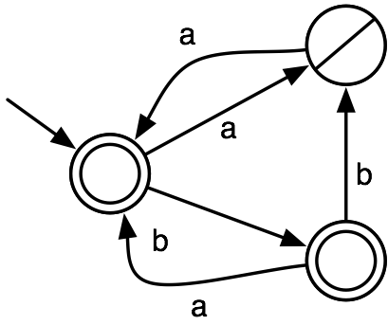
Answer
, b

Slide 77
Answer
, b

Slide 78
 | _ | a | b | aa | ab | ba | bb | aaa | aab | aba
_ | 1 | 0 | 1 | 1 | 1 | 1 | 0 | 0 | 1 | 0
a | 0 | 1 | 1 | 0 | 1 | 0 | 1 | 1 | 1 | 1
b | 1 | 1 | 0 | 0 | 1 | 1 | 1 | 1 | 1 | 1
aa | 1 | 0 | 1 | 1 | 1 | 1 | 0 | 0 | 1 | 0
ab | 1 | 0 | 1 | 1 | 1 | 1 | 0 | 0 | 1 | 0
ba | 1 | 0 | 1 | 1 | 1 | 1 | 0 | 0 | 1 | 0
bb | 0 | 1 | 1 | 0 | 1 | 0 | 1 | 0 | 1 | 1
aaa | 0 | 1 | 1 | 0 | 1 | 0 | 1 | 1 | 1 | 1
aab | 1 | 1 | 0 | 0 | 1 | 1 | 1 | 1 | 1 | 1
aba | 0 | 1 | 1 | 0 | 1 | 0 | 1 | 1 | 1 | 1

Slide 79
_
a
b
aa
ab
ba
bb
aaa
aab
aba
Look at colors of Hankel Matrix rows

Slide 80
_
a
b
aa
ab
ba
bb
access strings and one-letter extensions provide sufficient information
, b

Slide 81
_
a
b
aa
ab
ba
bb
access strings and one-letter extensions provide sufficient information
, b
Forms the basis for
state machine learning algorithms

Slide 82
state machine learning

Slide 83
(a,+) (b,-) (aba,+) (abaa,-) (bbb,+) (bba,+)
 | _ | a | b | ba | aba | aa | baa | abaa | bb | bbb | bba
_ |  | 1 | 0 |  | 1 |  |  | 0 |  | 1 | 1
a | 1 |  |  | 1 |  |  | 0
b | 0 |  |  | 1 |  |  |  |  | 1
ab |  | 1 |  |  |  | 0
aba | 1 | 0
abaa | 0
bb |  | 1 | 1
bbb | 1
bba | 1

Slide 84
(a,+) (b,-) (aba,+) (abaa,-) (bbb,+) (bba,+)
 | _ | a | b | ba | aba | aa | baa | abaa | bb | bbb | bba
_ |  | 1 | 0 |  | 1 |  |  | 0 |  | 1 | 1
a | 1 |  |  | 1 |  |  | 0
b | 0 |  |  | 1 |  |  |  |  | 1
ab |  | 1 |  |  |  | 0
aba | 1 | 0
abaa | 0
bb |  | 1 | 1
bbb | 1
bba | 1
_
a
b
ab
aba
abaa
bb
bbb
bba

Slide 85
(a,+) (b,-) (aba,+) (abaa,-) (bbb,+) (bba,+)
 | _ | a | b | ba | aba | aa | baa | abaa | bb | bbb | bba
_ |  | 1 | 0 |  | 1 |  |  | 0 |  | 1 | 1
a | 1 |  |  | 1 |  |  | 0
b | 0 |  |  | 1 |  |  |  |  | 1
ab |  | 1 |  |  |  | 0
aba | 1 | 0
abaa | 0
bb |  | 1 | 1
bbb | 1
bba | 1
_
a
b
ab
aba
abaa
bb
bbb
bba

Slide 86
(a,+) (b,-) (aba,+) (abaa,-) (bbb,+) (bba,+)
 | _ | a | b | ba | aba | aa | baa | abaa | bb | bbb | bba
_ |  | 1 | 0 |  | 1 |  |  | 0 |  | 1 | 1
a | 1 |  |  | 1 |  |  | 0
b | 0 |  |  | 1 |  |  |  |  | 1
ab |  | 1 |  |  |  | 0
aba | 1 | 0
abaa | 0
bb |  | 1 | 1
bbb | 1
bba | 1
Try to make state machine...
_
a
b
ab
aba
abaa
bb
bbb
bba

Slide 87
(a,+) (b,-) (aba,+) (abaa,-) (bbb,+) (bba,+)
 | _ | a | b | ba | aba | aa | baa | abaa | bb | bbb | bba
_ |  | 1 | 0 |  | 1 |  |  | 0 |  | 1 | 1
a | 1 |  |  | 1 |  |  | 0
b | 0 |  |  | 1 |  |  |  |  | 1
ab |  | 1 |  |  |  | 0
aba | 1 | 0
abaa | 0
bb |  | 1 | 1
bbb | 1
bba | 1
Try to make state machine...
It is inconsistent!
(b and bb end in same state,
but bbb does not)
_
a
b
ab
aba
abaa
bb
bbb
bba

Slide 88
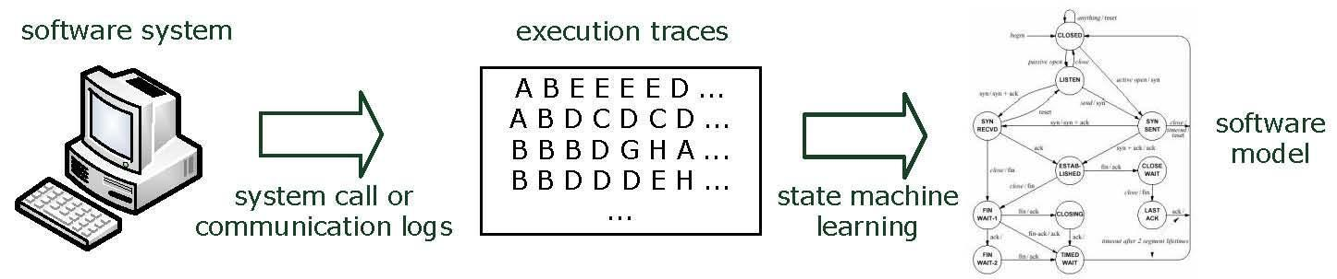
We need more information…
Queries (input)
Active learning

Slide 89
 | _ | a | b | ba | aba | aa | baa | abaa | bb | bbb | bba
_ |  | 1 | 0 |  | 1 |  |  | 0 |  | 1 | 1
a | 1 |  |  | 1 |  |  | 0
b | 0 |  |  | 1 |  |  |  |  | 1
ab |  | 1 |  |  |  | 0
aba | 1 | 0
abaa | 0
bb |  | 1 | 1
bbb | 1
bba | 1
What to ask?

Slide 90
Ask: bb
 | _ | a | b | ba | aba | aa | baa | abaa | bb | bbb | bba
_ |  | 1 | 0 |  | 1 |  |  | 0 |  | 1 | 1
a | 1 |  |  | 1 |  |  | 0
b | 0 |  |  | 1 |  |  |  |  | 1
ab |  | 1 |  |  |  | 0
aba | 1 | 0
abaa | 0
bb |  | 1 | 1
bbb | 1
bba | 1

Slide 91
Ask: bb
 | _ | a | b | ba | aba | aa | baa | abaa | bb | bbb | bba
_ |  | 1 | 0 |  | 1 |  |  | 0 |  | 1 | 1
a | 1 |  |  | 1 |  |  | 0
b | 0 |  | 1 | 1 |  |  |  |  | 1
ab |  | 1 |  |  |  | 0
aba | 1 | 0
abaa | 0
bb | 1 | 1 | 1
bbb | 1
bba | 1
If + _ distinguishes between b and bb

Slide 92
Ask: bb
 | _ | a | b | ba | aba | aa | baa | abaa | bb | bbb | bba
_ |  | 1 | 0 |  | 1 |  |  | 0 |  | 1 | 1
a | 1 |  |  | 1 |  |  | 0
b | 0 |  | 0 | 1 |  |  |  |  | 1
ab |  | 1 |  |  |  | 0
aba | 1 | 0
abaa | 0
bb | 0 | 1 | 1
bbb | 1
bba | 1
If - b distinguishes between b and bb

Slide 93
Active learning with L*
Aims to discover:
access strings, smallest strings for every color
one-letter extensions, and
their distinguishing suffixes
Maintains a distinguishing table
Which distinguishing suffixes is determined during learning
 | _ | a
_ | 1 | 0
a | 0 | 1
b | 1 | 1
aa | 1 | 0
ab | 1 | 0
ba | 1 | 0
bb | 0 | 1

Slide 94
Active learning with L*
Start with an empty table, with one access string and one distinguishing extension:
_ and _
Ask membership queries for _ and its one letter extensions:
_ in L? → yes
a in L? → no
b in L? → yes
 | _
_ | 1
a | 0
b | 1

Slide 95
Active learning with L*
Can we construct a state machine?
No!
a points to a new state
Ask membership queries for its one-letter extensions:
aa in L? → yes
ab in L? → yes
 | _
_ | 1
a | 0
b | 1
aa | 1
ab | 1

Slide 96
Active learning with L*
Can we construct a state machine?
Yes!
Ask an equivalence query:
L(M) = L? → no, M for instance accepts aabbaa
 | _
_ | 1
a | 0
b | 1
aa | 1
ab | 1

Slide 97
Active learning with L*
C = aabbaa, -
Where does M make a mistake?
Replace c prefixes with reached access strings
Ask membership queries:
_bbaa in L? → no
_baa in L? → no
_aa in L? → yes
 | _
_ | 1
a | 0
b | 1
aa | 1
ab | 1

Slide 98
Active learning with L*
C = aabbaa, -
Where does M make a mistake?
Replace c prefixes with reached access strings
Ask membership queries:
_bbaa in L? → no
_baa in L? → no
_aa in L? → yes
 | _
_ | 1
a | 0
b | 1
aa | 1
ab | 1
aa is a new
distinguishing extension!

Slide 99
Active learning with L*
Add the column aa
Ask membership queries to complete the table
 | _ | aa
_ | 1 | 1
a | 0 | 0
b | 1 | 0
aa | 1 | 1
ab | 1 | 1

Slide 100
Active learning with L*
Add the column aa
Ask membership queries to complete the table
b points to a new state
Add its one-letter extensions, ask membership queries to complete
 | _ | aa
_ | 1 | 1
a | 0 | 0
b | 1 | 0
aa | 1 | 1
ab | 1 | 1
ba | 1 | 1
bb | 0 | 0

Slide 101
Active learning with L*
Add the column aa
Ask membership queries to complete the table
b points to a new state
Add its one-letter extensions, ask membership queries to complete
 | _ | aa
_ | 1 | 1
a | 0 | 0
b | 1 | 0
aa | 1 | 1
ab | 1 | 1
ba | 1 | 1
bb | 0 | 0
The table defines a state machine, ask an equivalence query → yes!
Done

Slide 102
Active learning with L*
Initialize the distinguishing table T
Complete T until it defines a state machine M
While( Eq(M) gives a counterexample c )
Use Mem() and c to find a new distinguishing extension d
Add d to T
Complete T until it defines a state machine M

Slide 103
L* - some theory
L* always finds a state machine for the target language
A distinguishing extension can always be found using the counterexample
Completing T terminates since we only have to add one-letter extensions once for every color
Once all states are identified, Eq(M) will return yes
L* runs in polynomial time and from polynomial data!
Both O(n²), n number of states of smallest target

Slide 104
Active automaton learning
Learnlib is an L* implementation that can be applied to software
Uses model-based testing methods for answering equivalence queries
We are currently combining this with fuzzing for security purposes
The learned models allow to:
Investigate the model for any implementation flaws
Compare models from different implementations
…
Demo…

Slide 105
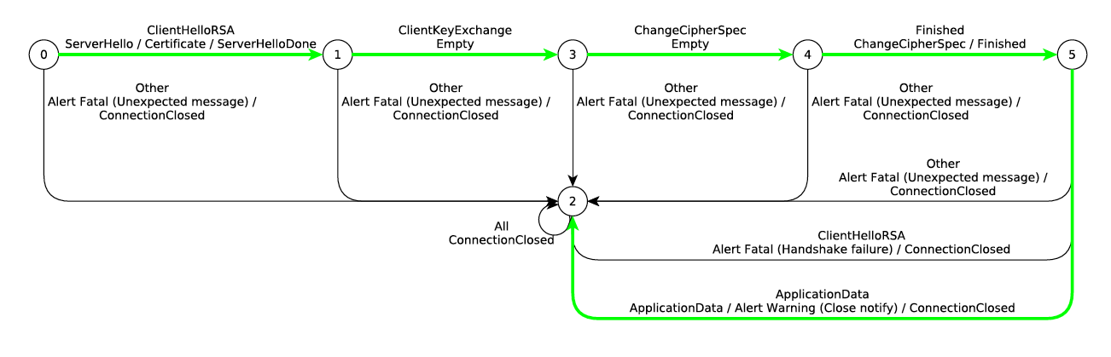
TLS RSA BSAFE
Joeri de Ruiter & Erik Poll 2015

Slide 106
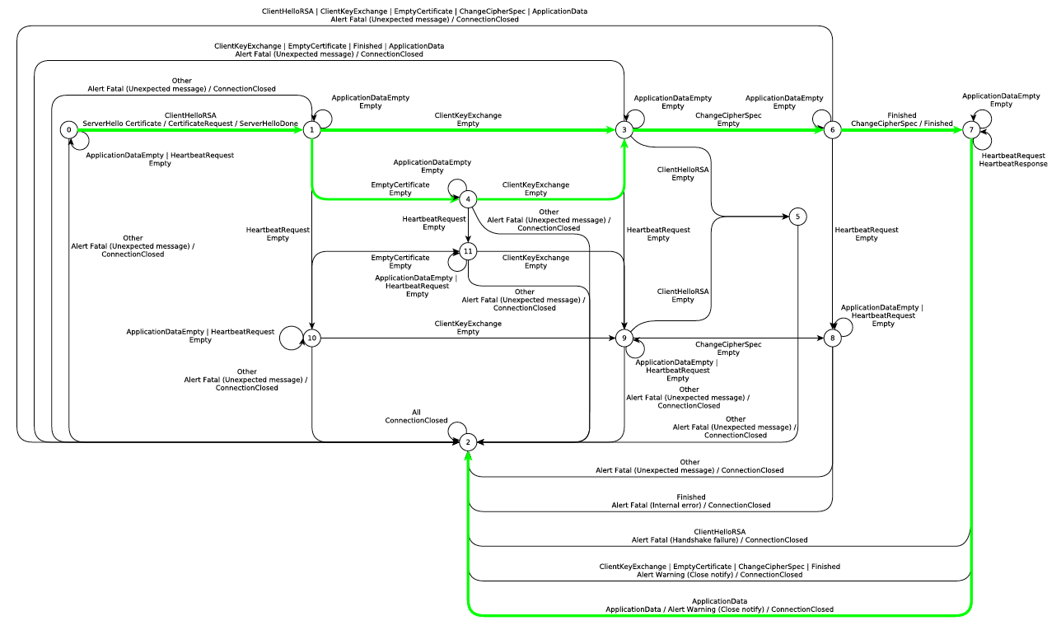
GNU TLS 3.3.8
Joeri de Ruiter & Erik Poll 2015

Slide 107
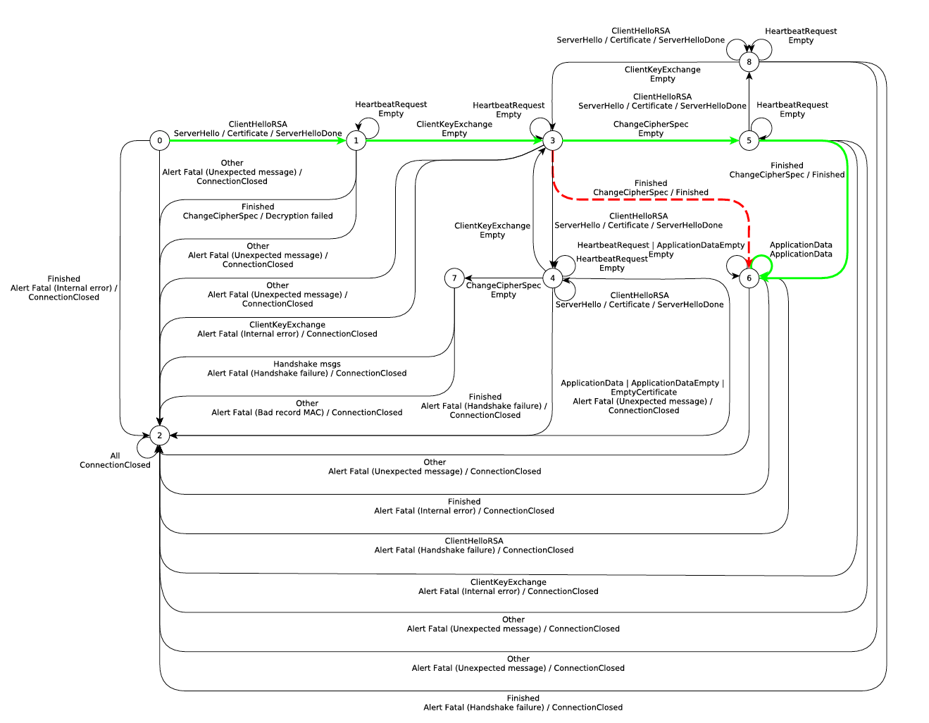
JSSE 1.8.0
Joeri de Ruiter & Erik Poll 2015

Slide 108
Use the information we have…
Passive learning

Slide 109
Key issue: coloring leads to inconsistencies
 | _ | a | b | ba | aba | aa | baa | abaa | bb | bbb | bba
_ |  | 1 | 0 |  | 1 |  |  | 0 |  | 1 | 1
a | 1 |  |  | 1 |  |  | 0
b | 0 |  |  | 1 |  |  |  |  | 1
ab |  | 1 |  |  |  | 0
aba | 1 | 0
abaa | 0
bb |  | 1 | 1
bbb | 1
bba | 1
_
a
b
ab
aba
abaa
bb
bbb
bba

Slide 110
Key issue: coloring leads to inconsistencies
 | _ | a | b | ba | aba | aa | baa | abaa | bb | bbb | bba
_ |  | 1 | 0 |  | 1 |  |  | 0 |  | 1 | 1
a | 1 |  |  | 1 |  |  | 0
b | 0 |  |  | 1 |  |  |  |  | 1
ab |  | 1 |  |  |  | 0
aba | 1 | 0
abaa | 0
bb |  | 1 | 1
bbb | 1
bba | 1
Oh, and it is NP-hard…
_
a
b
ab
aba
abaa
bb
bbb
bba

Slide 111
Solution: state merging
Very effective greedy method
Initially assume a large DFA
Iteratively combine similar states
Until no more state can be combined
State-of-the-art since 1998

Slide 112
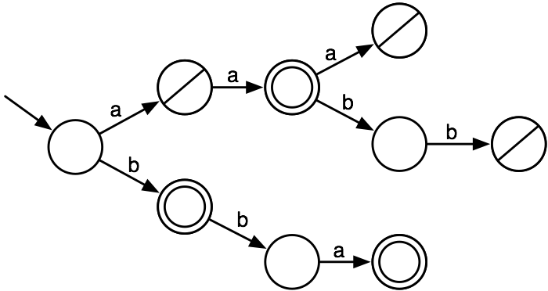
State merging
positive data: aa, b, bba; negative data: a, aaa, aabb
represented as a prefix tree

Slide 113
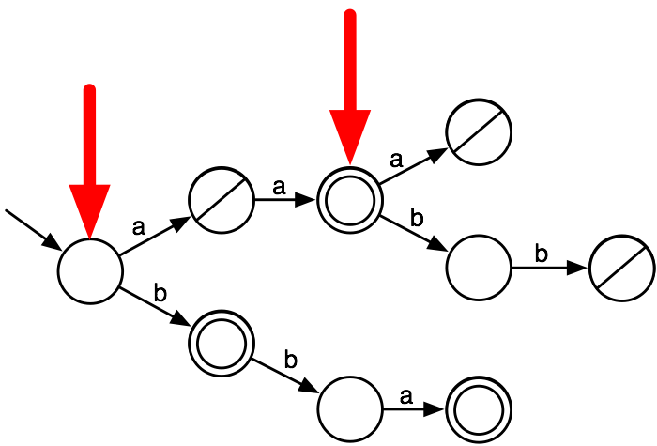
State merging
State merging:
select two nodes

Slide 114

State merging
State merging:
move input transitions from one state to the other

Slide 115

State merging
State merging:
move output transitions from one state to the other

Slide 116

State merging
State merging:
move output transitions from one state to the other

Slide 117
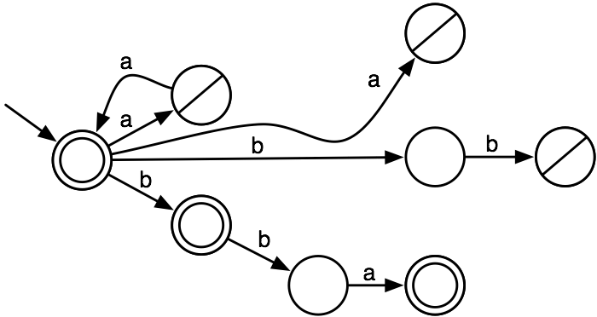
State merging
State merging:
delete the obsolete state, maintain positive/negative

Slide 118
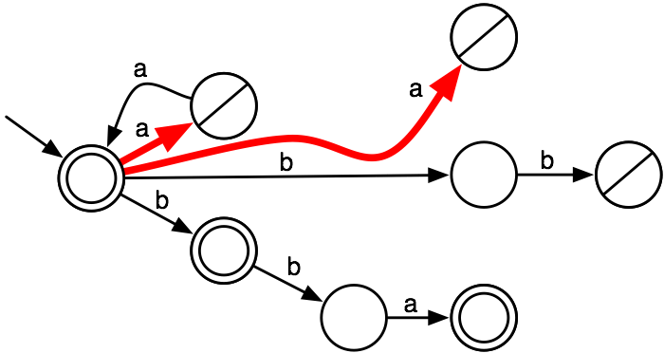
State merging
Determinization:
merge the targets of non-deterministic transitions

Slide 119
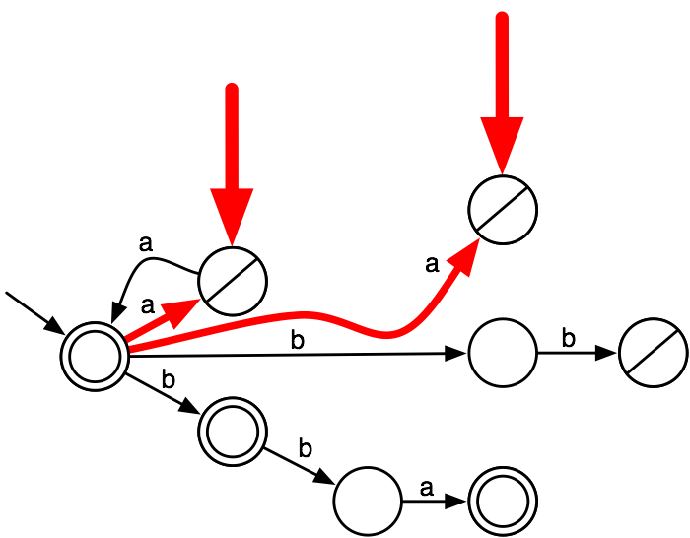
State merging
Determinization:
merge the targets of non-deterministic transitions

Slide 120
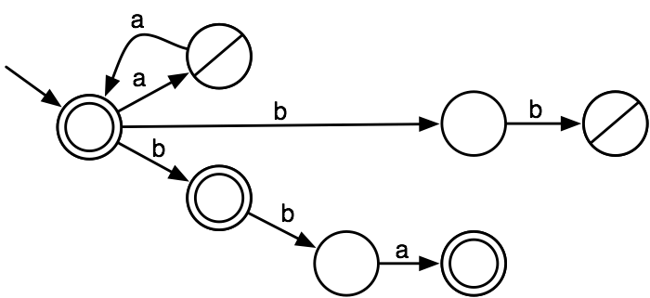
State merging
Determinization:
merge the targets of non-deterministic transitions

Slide 121
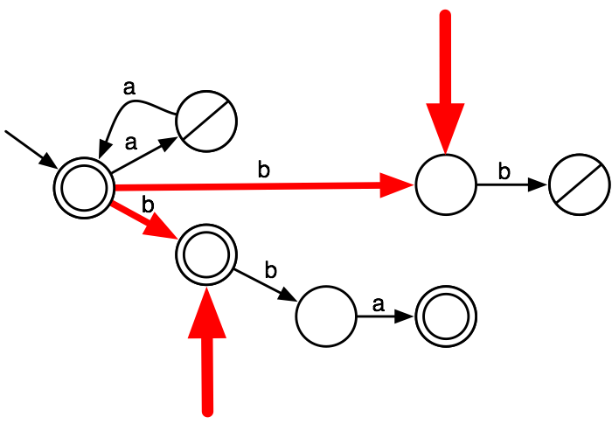
State merging
Determinization:
merge the targets of non-deterministic transitions

Slide 122

State merging
Determinization:
merge the targets of non-deterministic transitions

Slide 123
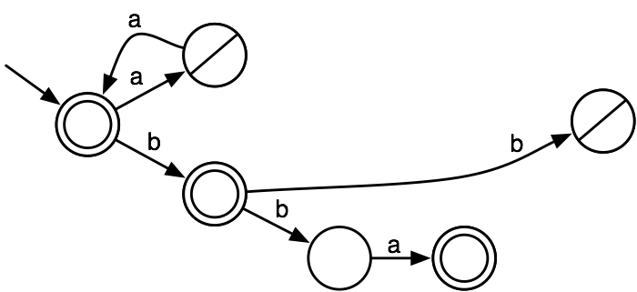
State merging
Determinization:
merge the targets of non-deterministic transitions

Slide 124
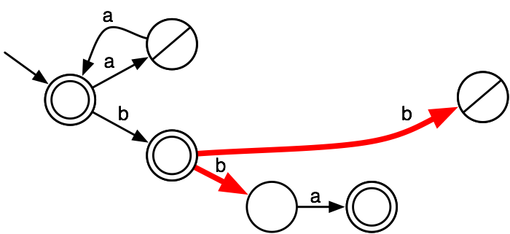
State merging
Select two new nodes to merge and iterate

Slide 125
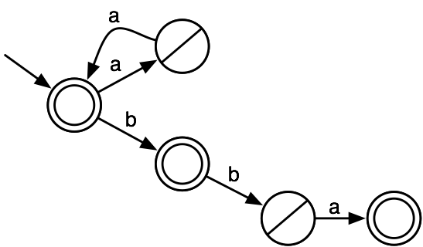
State merging
Select two new nodes to merge and iterate

Slide 126
State merging (RPNI)
Start from a prefix tree acceptor
Color the initial state red, and it’s children blue
Let B be the first blue state in lexicographical order (a,b,aa,ab,ba,bb,aaa,aab,aba,abb,…)
For all red states R in lexicographical order
Merge B with R
Break if consistent, undo the merge otherwise
Color B red if it is not merged
Color all children of red states blue
Goto 3

Slide 127
Convergence
How much data does RPNI need to learn
???
, b

Slide 128
Convergence
How much data does RPNI need to learn
???
(_,+)
(a,-)
(b,+)
(ba,+)
(aa,+)
(ab,+)
(bb,-)
(aaa,-)
(aba,-)
(baa,-)
, b

Slide 129
Convergence
How much data does RPNI need to learn
???
(_,+)
(a,-)
(b,+)
(ba,+)
(aa,+)
(ab,+)
(bb,-)
(aaa,-)
(aba,-)
(baa,-)
, b
polynomial
characteristic
set

Slide 130
Results
DFAs cannot be learned from unlabeled data
Learning DFAs from labeled data is hard, but
In the limit, RPNI requires only a polynomial amount of data to converge
If the data source is nice, we only need a polynomial amount of data and a polynomial-time algorithm

Slide 131
State machine learning key ingredients
When are two states consistent?
Positive gets merged with negative
Other events are possible
Statistics do not match
If the Markov property is violated
…
What to use as merge score?
Number of positive-positive, negative-negative merges
Overlap in sets of possible events
Statistical distance
…

Slide 132
Passive automaton learning
Learn a behavioral model from any event sequence
Use the model as a classifier
Analyze the model to understand its inner workings
DFASAT, my own tool to learn these models
based on state merging
translates part of the learning problem to Satisfiabiliy, and runs SAT-solvers to compute the best DFA
winner of the 2010 international state machine learning competition
allows many different consistency checks and score functions
possible to define your own
still needs work…
Demo…

Slide 133
DFASAT produces
1 9 1 0 0 0 0 0 0 0 0
1 15 0 1 1 0 0 0 1 0 1 0 1 0 1 0 0
0 5 0 1 0 0 0
1 2 0 0
0 12 1 1 0 0 0 0 0 0 0 1 0 0
1 5 1 0 1 0 0
1 3 1 0 0
0 6 0 0 0 0 0 1
1 3 1 0 1
0 20 1 0 0 0 0 0 1 0 1 0 0 0 0 0 1 1 1 0 0 0
0 13 0 1 1 1 0 1 0 0 0 0 0 0 0
1 3 1 0 1
1 7 1 0 0 0 0 0 0

Slide 134
DFASAT produces
1 9 1 0 0 0 0 0 0 0 0
1 15 0 1 1 0 0 0 1 0 1 0 1 0 1 0 0
0 5 0 1 0 0 0
1 2 0 0
0 12 1 1 0 0 0 0 0 0 0 1 0 0
1 5 1 0 1 0 0
1 3 1 0 0
0 6 0 0 0 0 0 1
1 3 1 0 1
0 20 1 0 0 0 0 0 1 0 1 0 0 0 0 0 1 1 1 0 0 0
0 13 0 1 1 1 0 1 0 0 0 0 0 0 0
1 3 1 0 1
1 7 1 0 0 0 0 0 0
….
10244 strings in total

